Slide 1
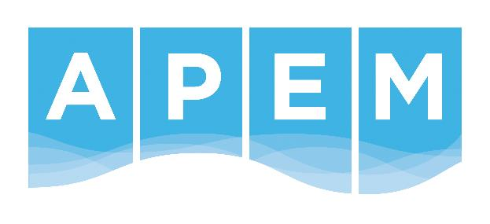
The restoration of Gypsey Race, Bridlington
Client: SWECO
Ultimate Client: East Riding Of Yorkshire Council
enquiries@apemltd.co.uk

Slide 2
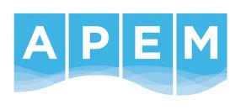
The restoration of Gypsey Race, Bridlington
Gypsey Race is Europe’s most northerly chalk stream and has experienced a long history of physical modification.
The river was over-wide, with minimal habitat variability and such shallow depths that fish passage was limited during most flows.
In its lower reaches, the river flows through the urban centre of Bridlington and is confined between walled revetments on both banks.
Restoration options were therefore limited and any measures could not increase flood or erosion risk.
In an urban renewal construction project led by SWECO for the East Riding Of Yorkshire Council, APEM provided outline restoration designs, and oversaw the construction of habitat enhancement measures for a total length of 350m of the urban river.
Notes:
Presentation abstract:
Over the last three years APEM have developed a number of innovative services and approaches specifically aimed at tackling the issues faced by Water Companies today, or those that they will face in the very near future. APEM’s approach has been to take our knowledge and experience of the challenges faced by water companies, and to try and find innovative solutions, rather than developing a technology, and then looking for a problem to solve. This approach culminated in APEM winning two water industry achievement awards during 2014. Our innovative services range from leakage detection from the air to detailed three dimensional asset surveying from high resolution multi spectral imaging

Slide 3
The restoration of Gypsey Race, Bridlington
APEM conducted an initial site walkover of each of the redevelopment reaches as well as an upstream reference reach.
We also carried out a desk-based assessment, using historical maps, flow data and previous ecological reports.
These provided a comprehensive understanding of the hydromorphological and ecological functioning of the watercourse.
APEM then used a combination of hydraulic model outputs and field data to design a series of habitat enhancements, including:
  reworking bed sediment into pools and riffles to increase habitat diversity for all life stages of target fish species; and
  installing berms to narrow the low-flow channel with the intention of increasing flow depth (to improve fish passage) and reducing fine sediment deposition.
Notes:
Presentation abstract:
Over the last three years APEM have developed a number of innovative services and approaches specifically aimed at tackling the issues faced by Water Companies today, or those that they will face in the very near future. APEM’s approach has been to take our knowledge and experience of the challenges faced by water companies, and to try and find innovative solutions, rather than developing a technology, and then looking for a problem to solve. This approach culminated in APEM winning two water industry achievement awards during 2014. Our innovative services range from leakage detection from the air to detailed three dimensional asset surveying from high resolution multi spectral imaging

Slide 4
The restoration of Gypsey Race, Bridlington
The urban nature of the site also necessitated some bed sediment replacement and APEM provided expert advice on sourcing gravels of appropriate particle size and chemical composition.
On completion of the design phases, APEM was contracted to provide regular expert on-site advice during construction to ensure that the designs were implemented to specification and to enable designs to be modified based on site conditions where necessary.
Given the changeable construction schedule, APEM adopted a flexible approach, with staff often deployed to site at short notice, and regular communication with the construction manager was essential.
Notes:
Presentation abstract:
Over the last three years APEM have developed a number of innovative services and approaches specifically aimed at tackling the issues faced by Water Companies today, or those that they will face in the very near future. APEM’s approach has been to take our knowledge and experience of the challenges faced by water companies, and to try and find innovative solutions, rather than developing a technology, and then looking for a problem to solve. This approach culminated in APEM winning two water industry achievement awards during 2014. Our innovative services range from leakage detection from the air to detailed three dimensional asset surveying from high resolution multi spectral imaging

Slide 5
Gypsey Race, Bridlington – typical design cross-section

Slide 6
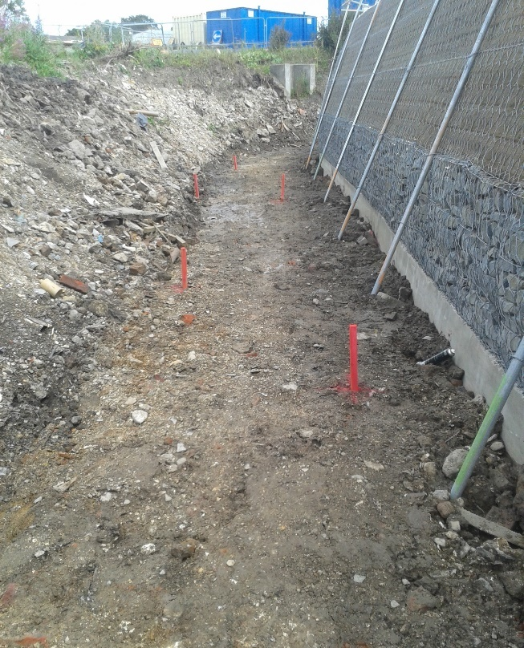
Gypsey Race, Bridlington – early construction phase

Slide 7
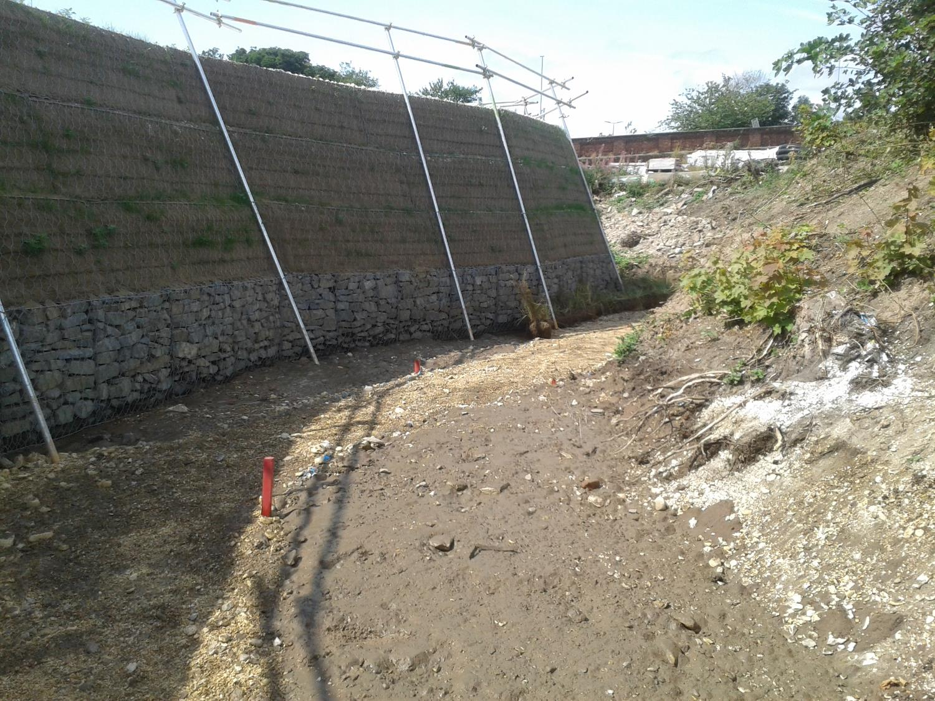
Gypsey Race, Bridlington – early construction phase

Slide 8
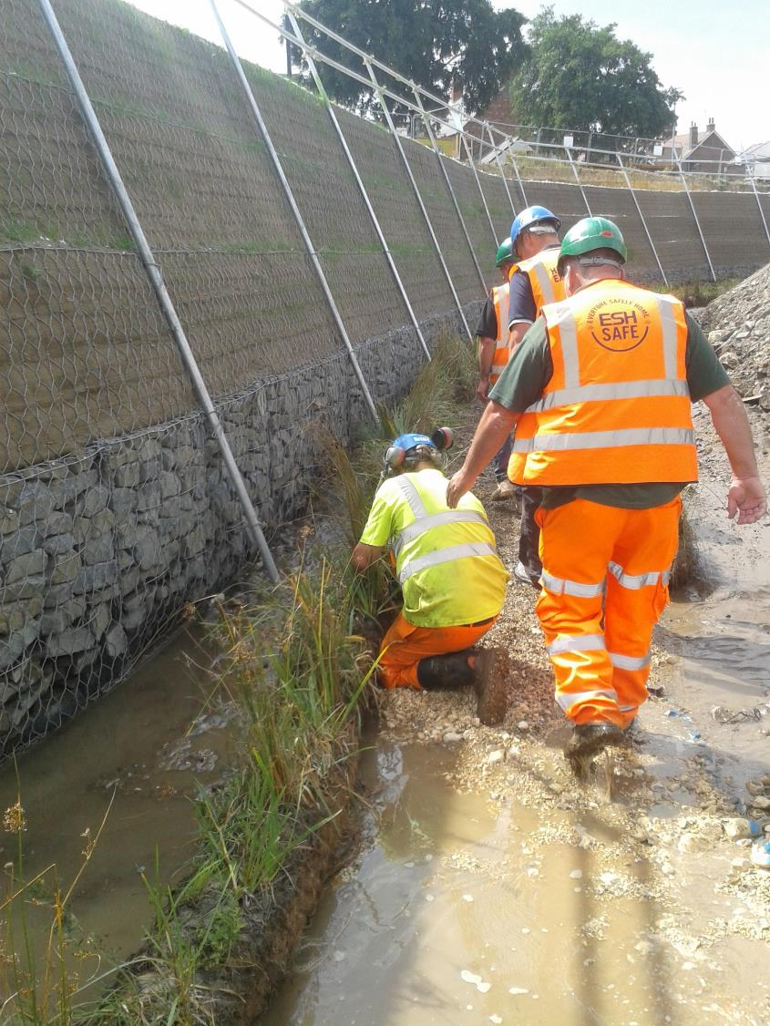
Gypsey Race, Bridlington – early construction phase

Slide 9
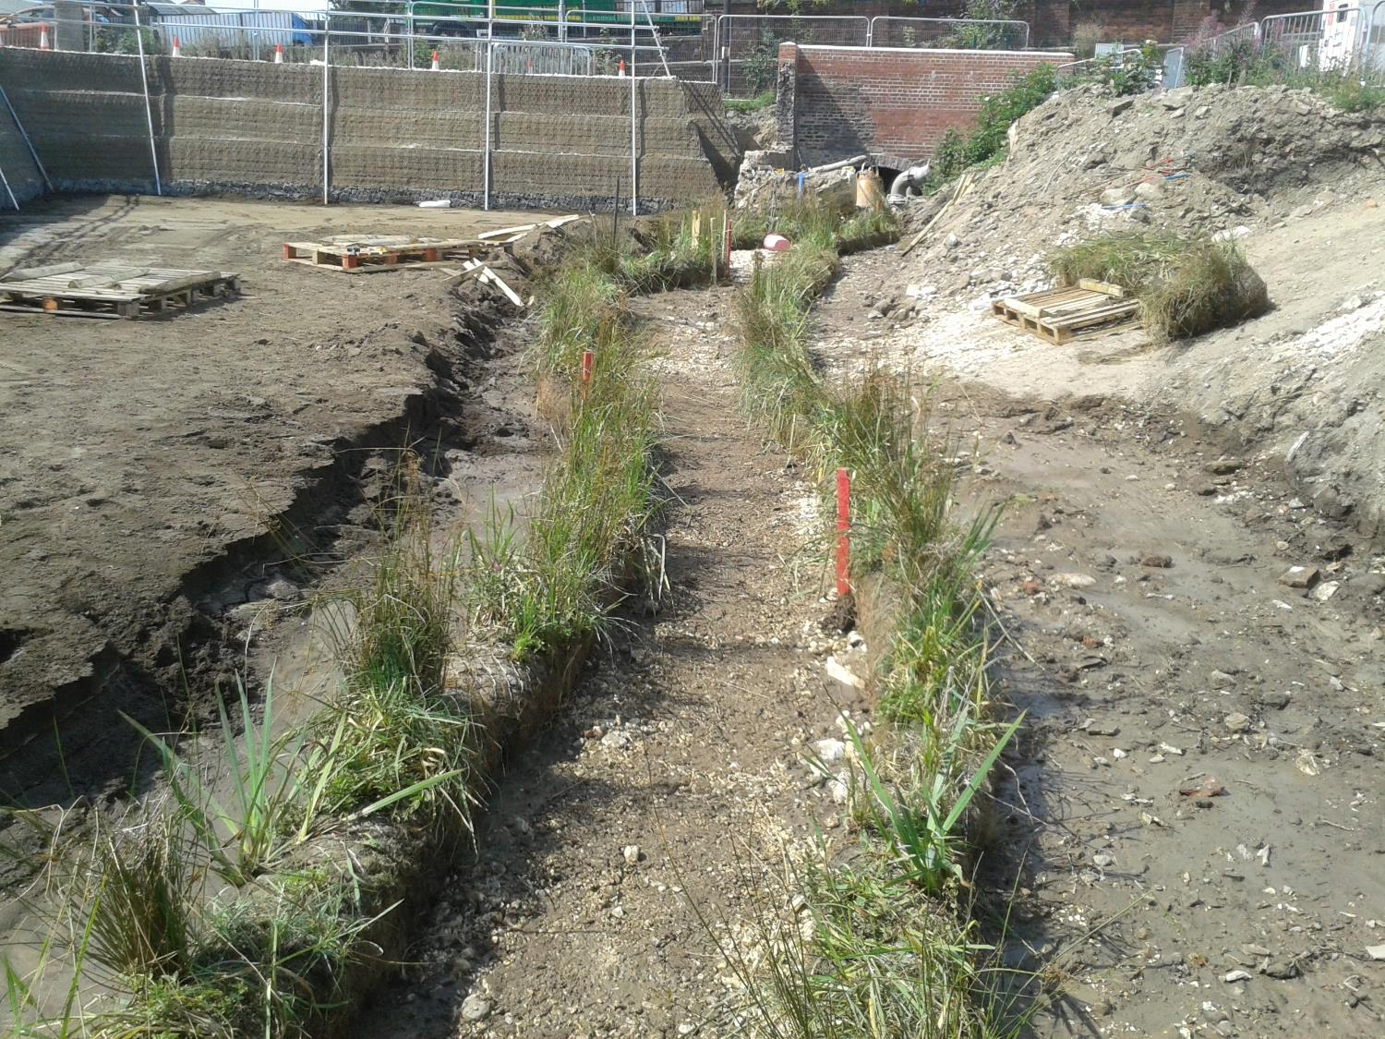
Gypsey Race, Bridlington – early construction phase

Slide 10
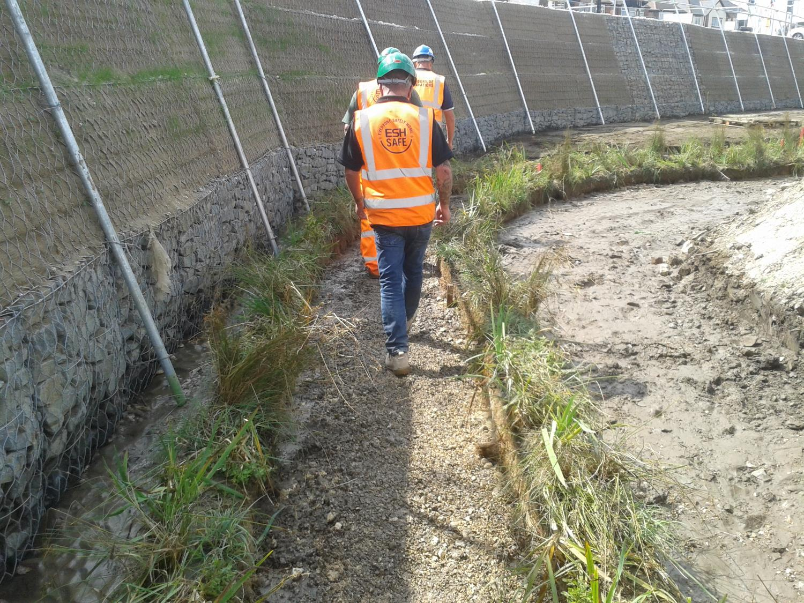
Gypsey Race, Bridlington – early construction phase

Slide 11
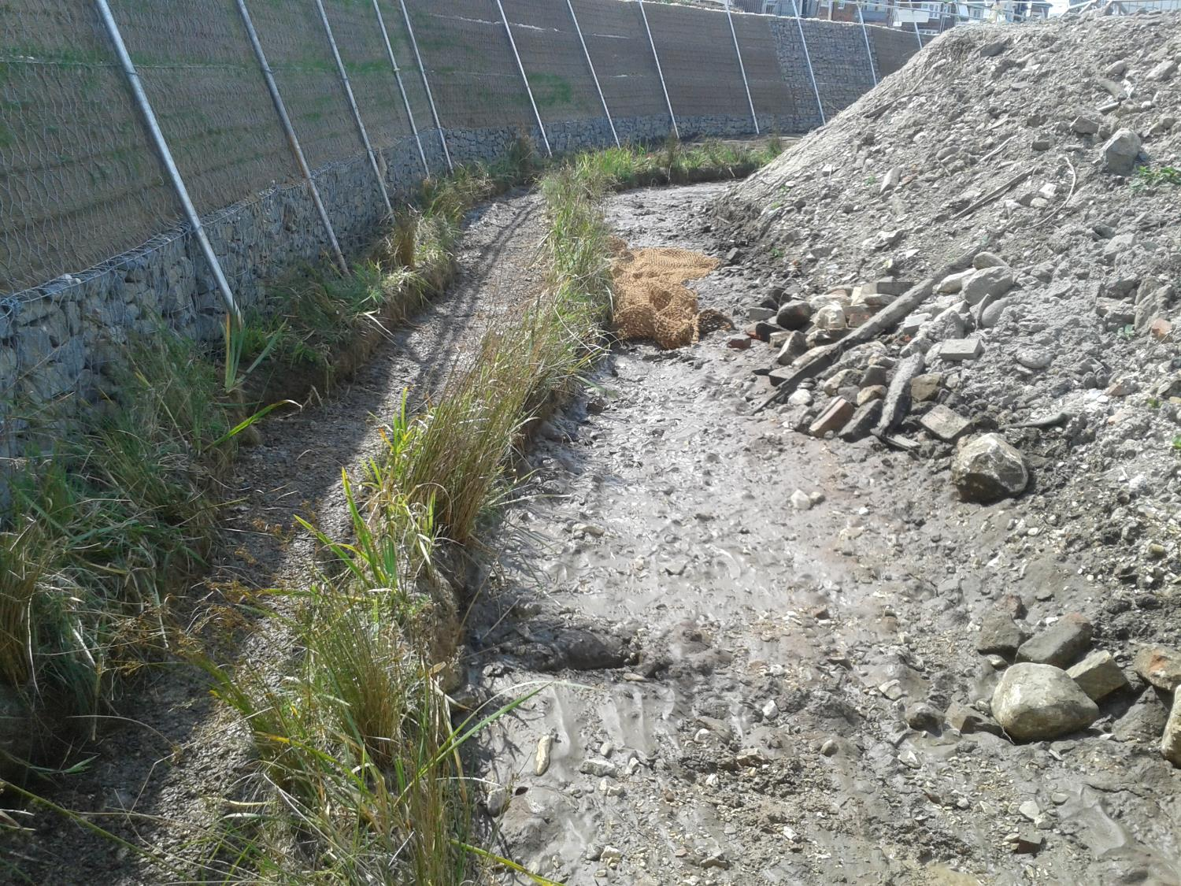
Gypsey Race, Bridlington – early construction phase

Slide 12
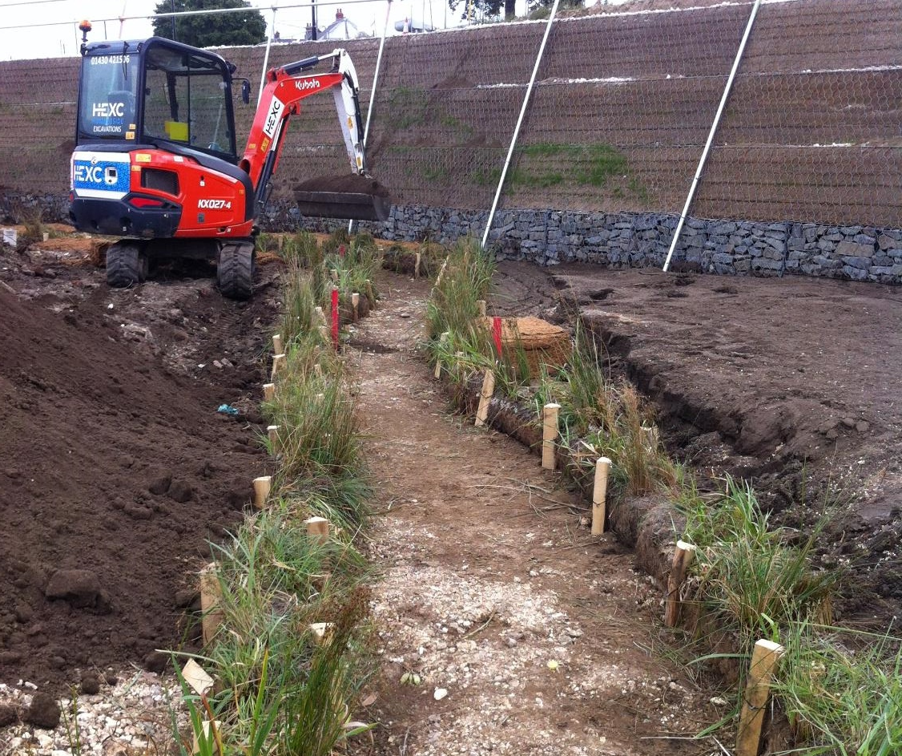
Gypsey Race, Bridlington – mid construction phase

Slide 13
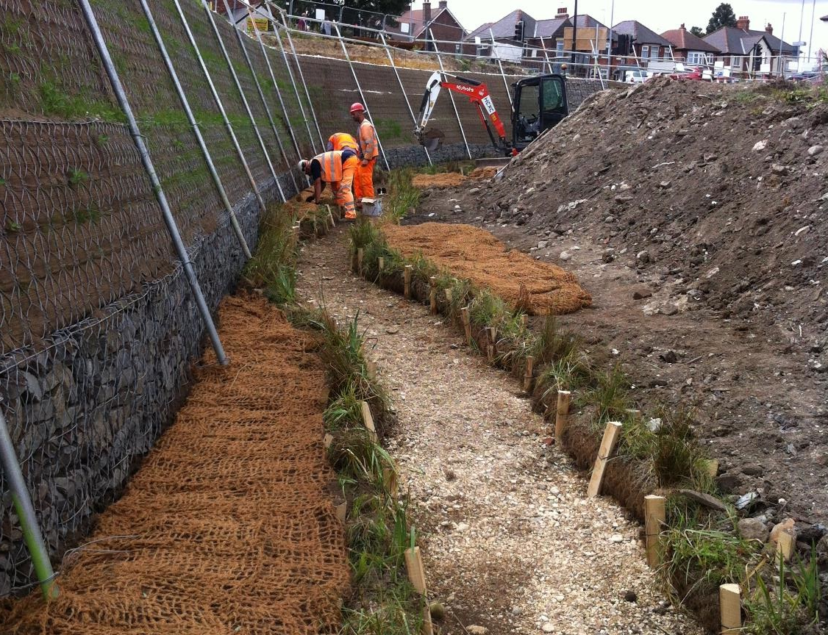
Gypsey Race, Bridlington – mid construction phase

Slide 14
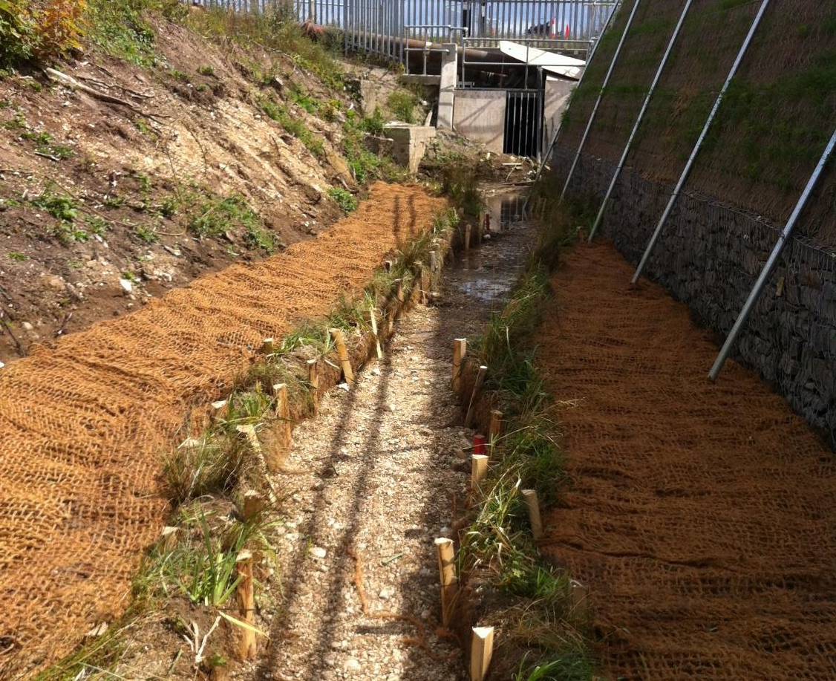
Gypsey Race, Bridlington – mid construction phase

Slide 15
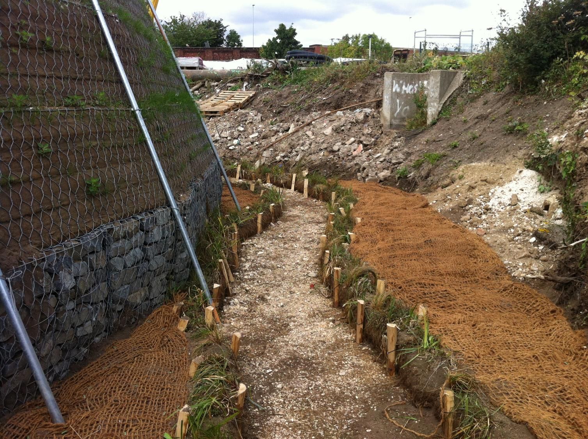
Gypsey Race, Bridlington – mid construction phase

Slide 16
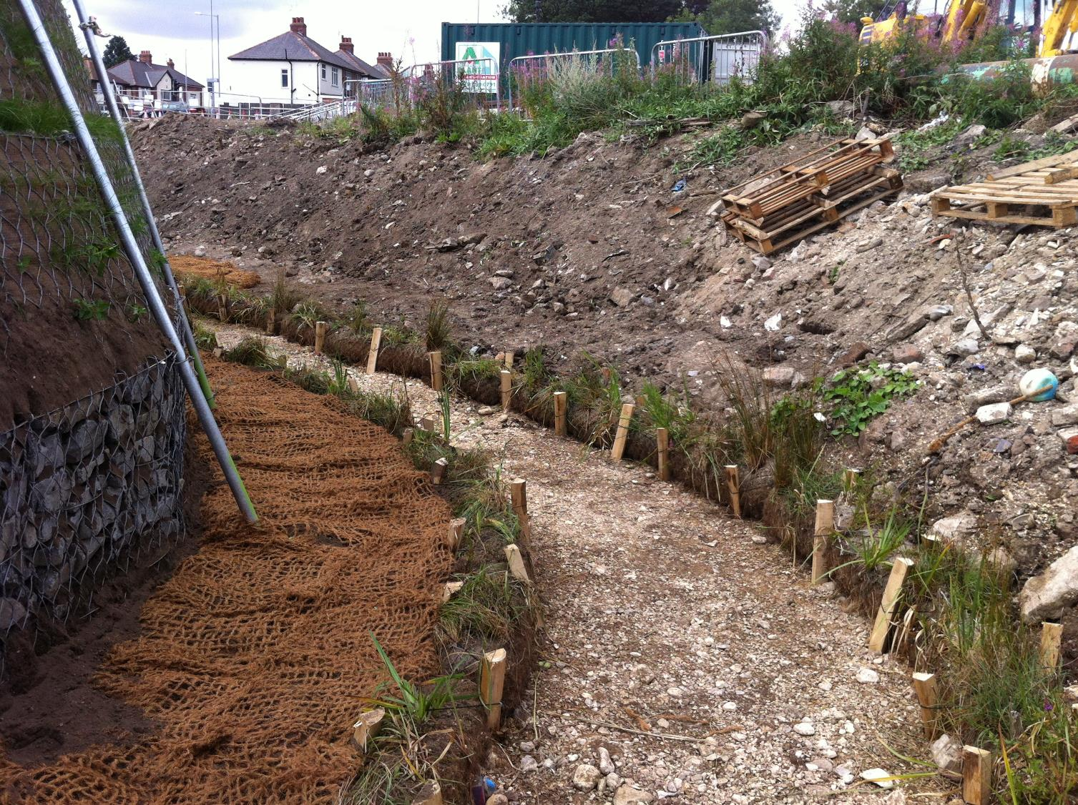
Gypsey Race, Bridlington – mid construction phase

Slide 17
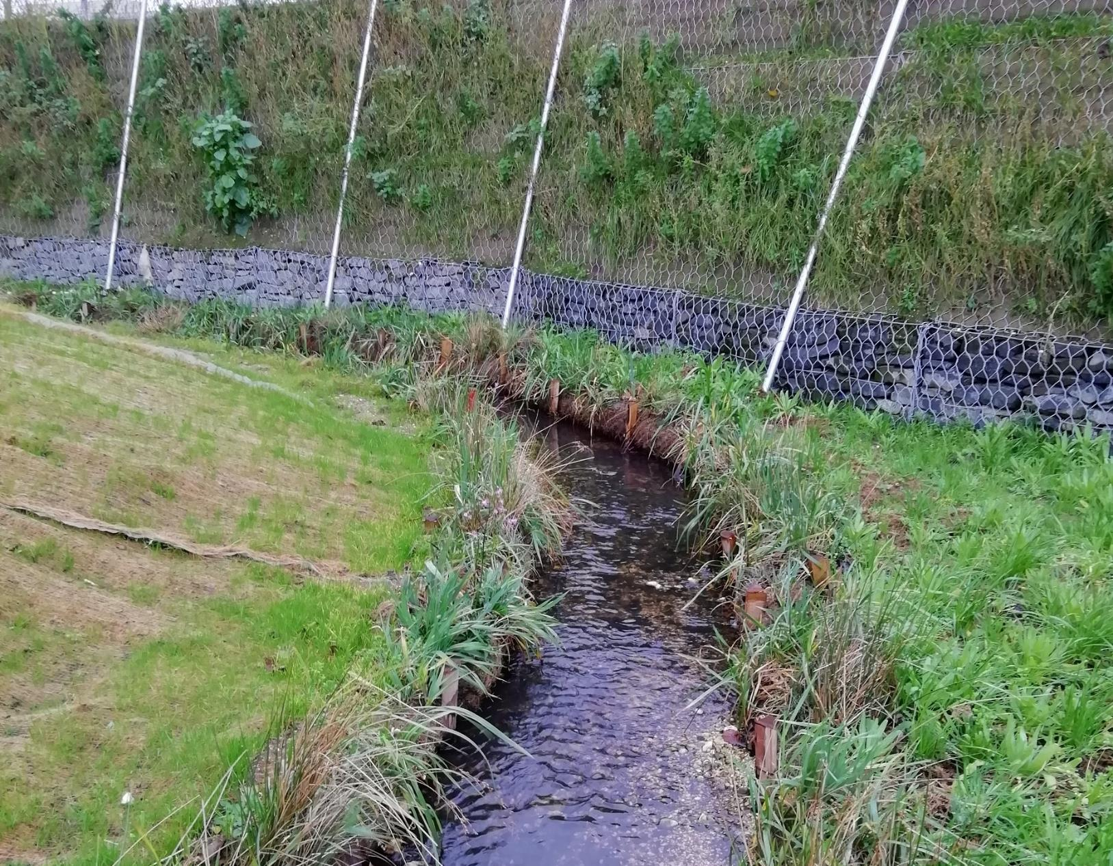
Gypsey Race, Bridlington – soon after completion

Slide 18
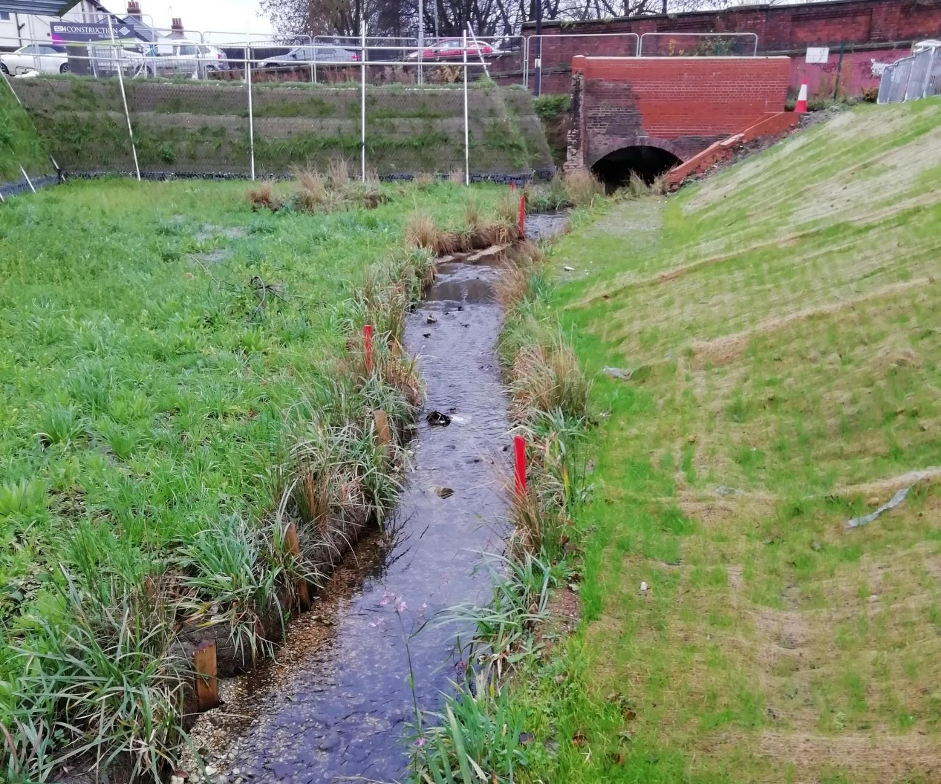
Gypsey Race, Bridlington – soon after completion

Slide 19
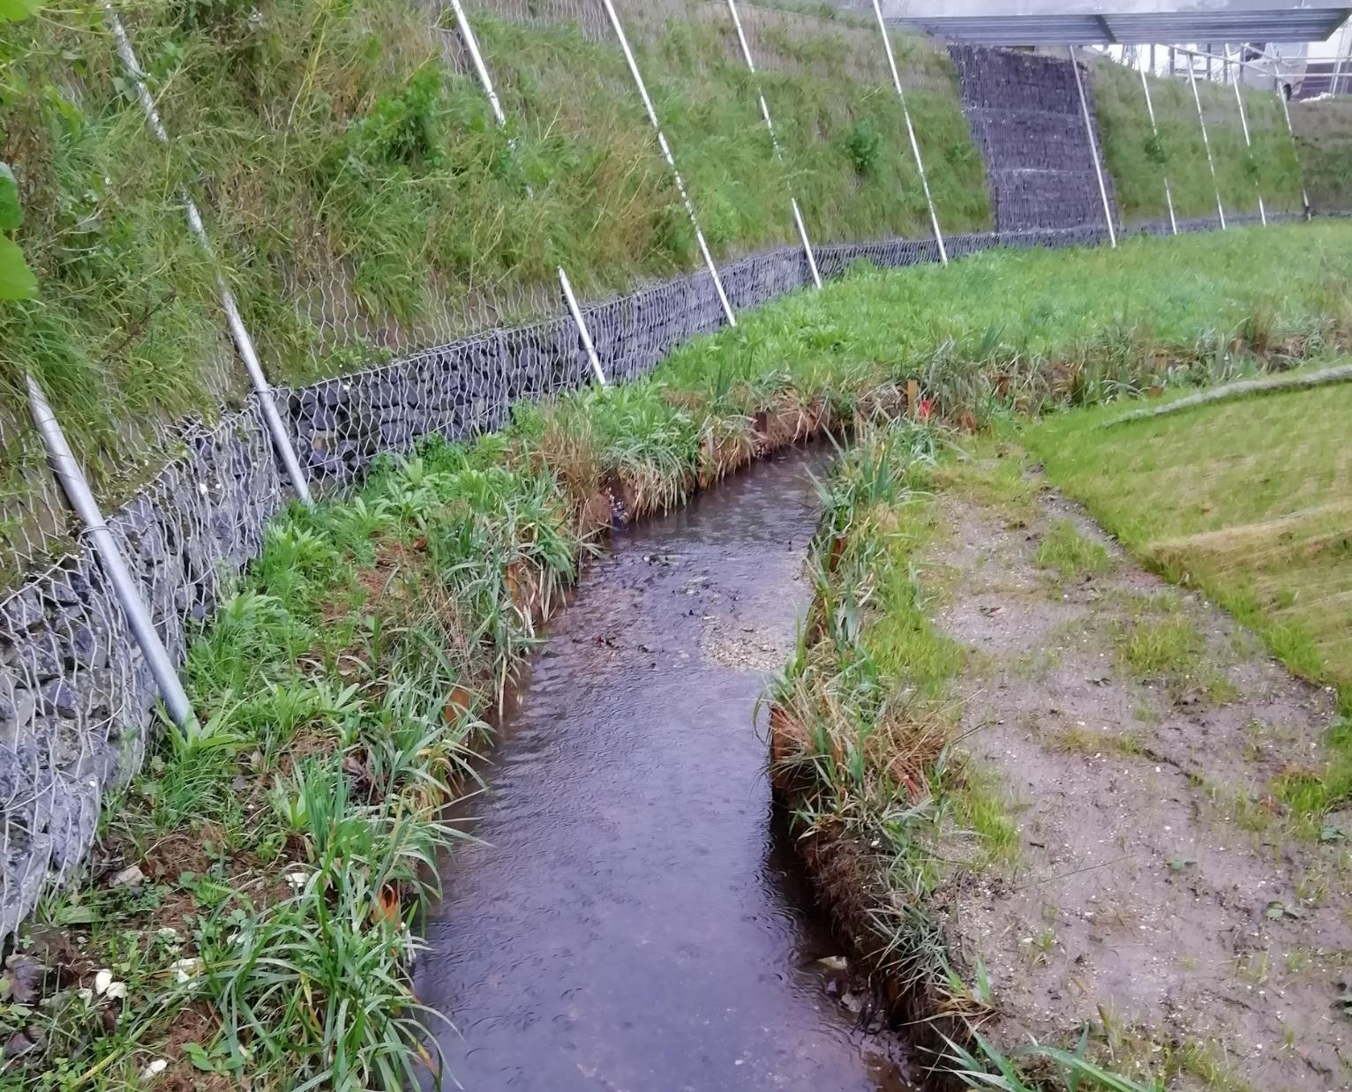
Gypsey Race, Bridlington – soon after completion

Slide 20
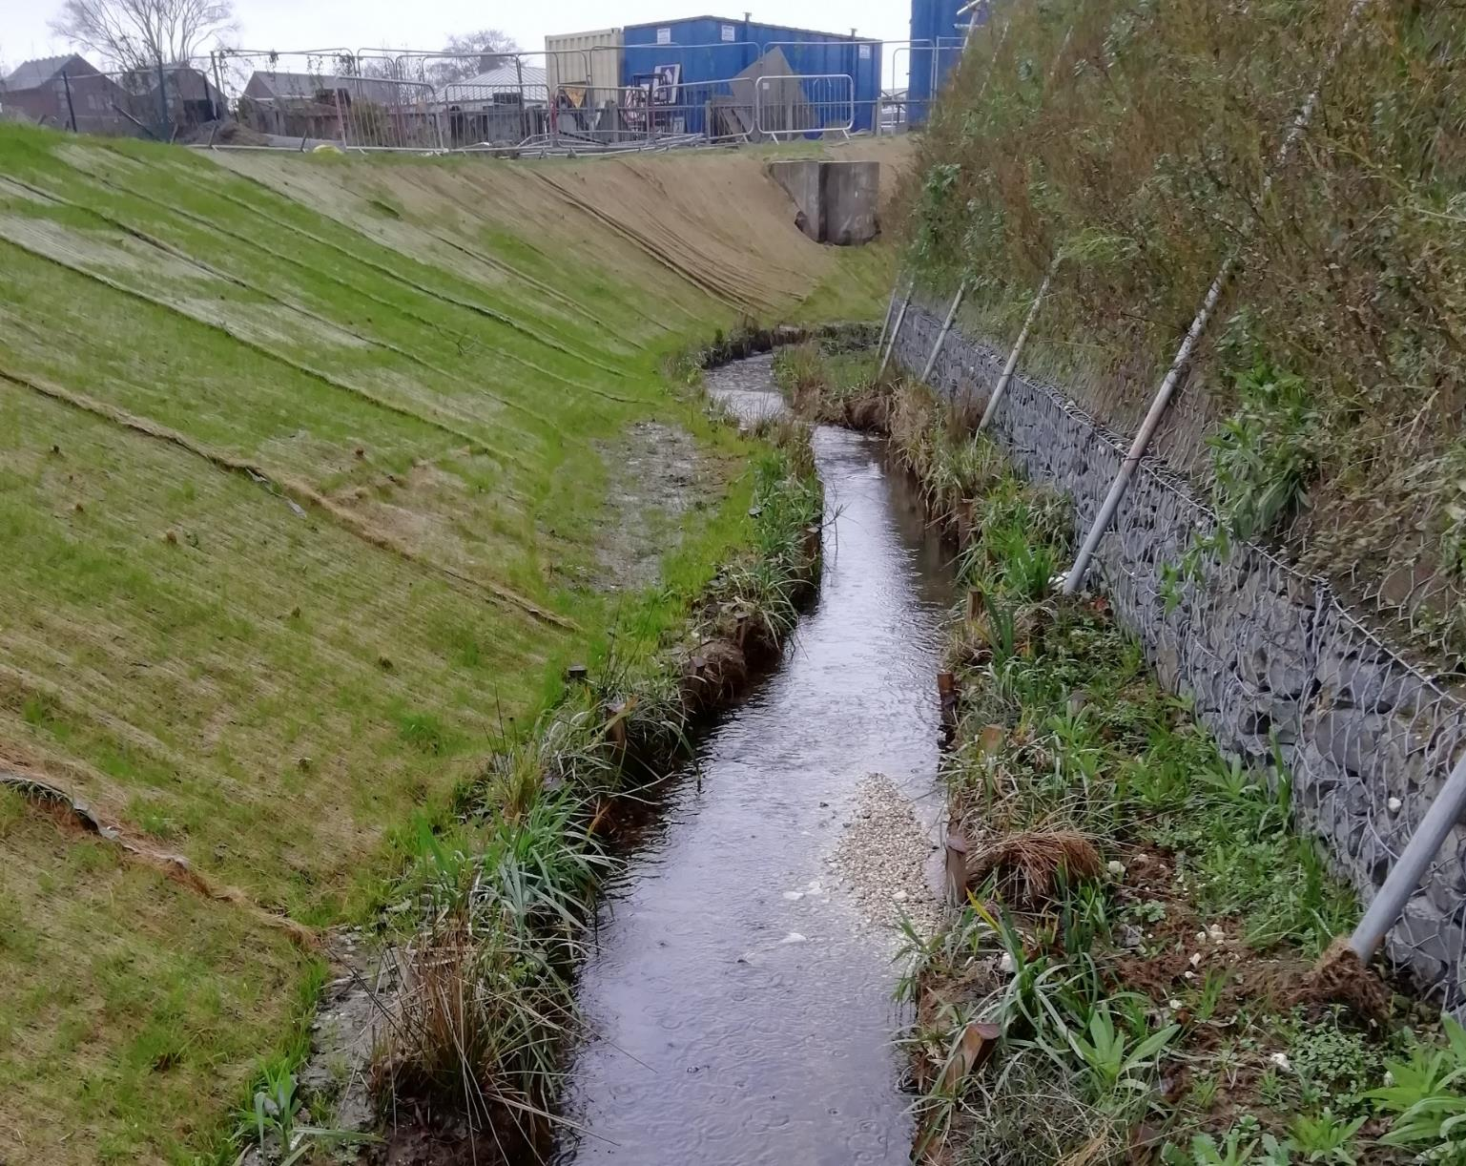
Gypsey Race, Bridlington – soon after completion

Slide 21
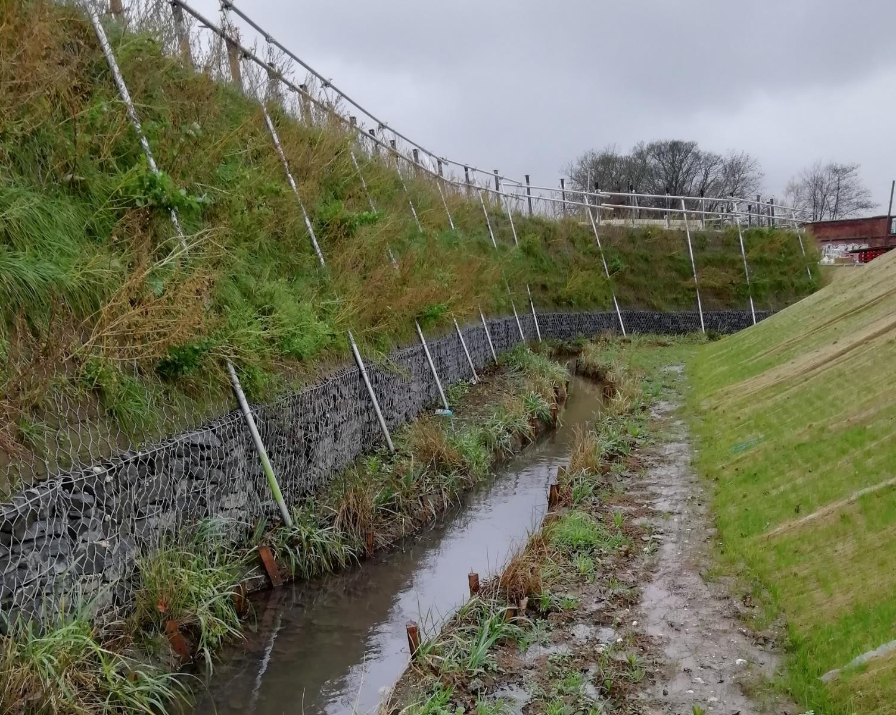
Gypsey Race, Bridlington – soon after completion

Slide 22
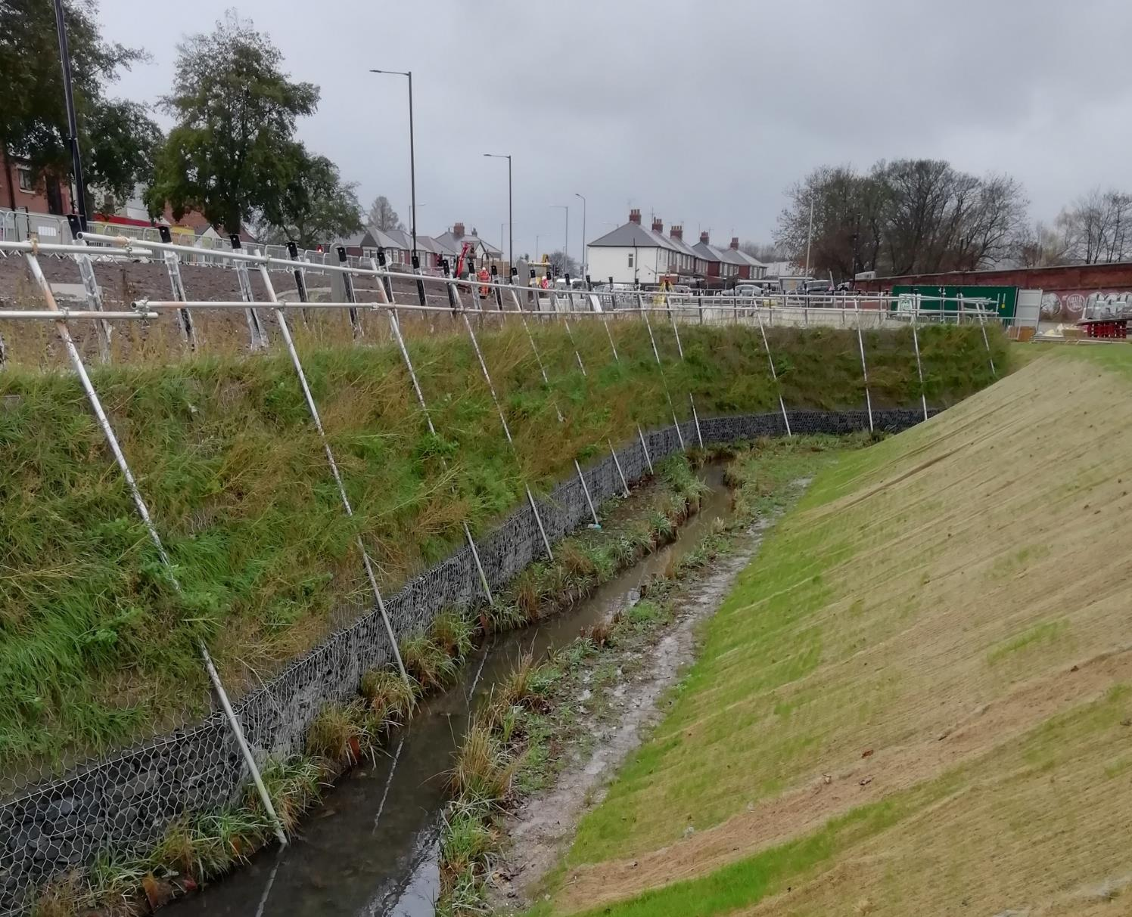
Gypsey Race, Bridlington – soon after completion

Slide 23
Thank you for watching
www.apemltd.co.uk
enquiries@apemltd.co.uk

